Slide 1
AdaptiveFlow: An Actor-based Framework to Design Flow Management Systems

Slide 2
Flow Management Systems
Warehouse Management System
Public Transportation System
Transporting Shuttles in a Closed Environment
Airport and Airspace Systems

Slide 3
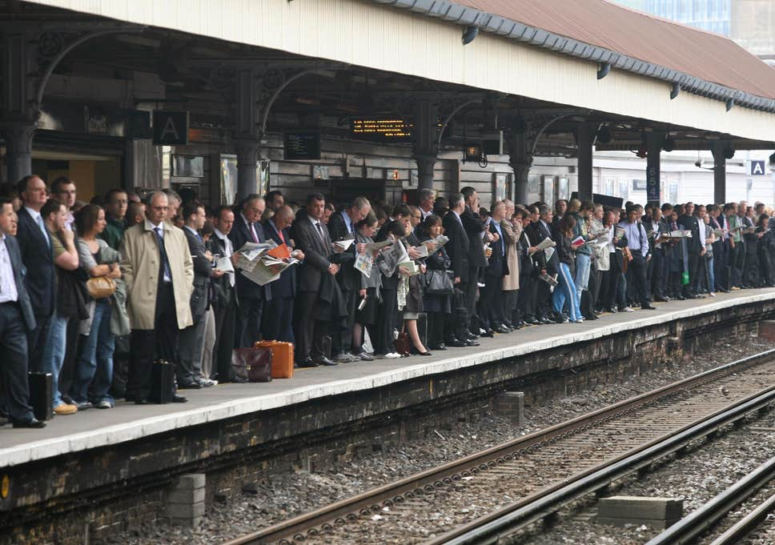
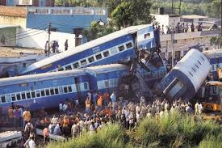
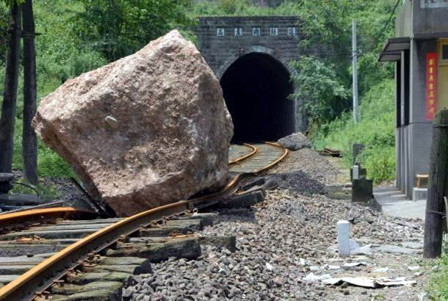
Challenges
Performance
Safety
Adaptation

Slide 4
Common Flow Pattern
Machines
robots
haulers
airplanes
trains
buses
shuttles
…
Environments
warehouse aisles
urban roards
airport tracks
metro tunnels
airspace
quarry roads
…
Assets
packages
stones
passengers
materials
animals
letters
…
Points of Interest
loading stations
wheel loader
airport runways
metro stops
parking stations
fuel stations
…
MOVING
TRANSPORTING
BETWEEN

Slide 5
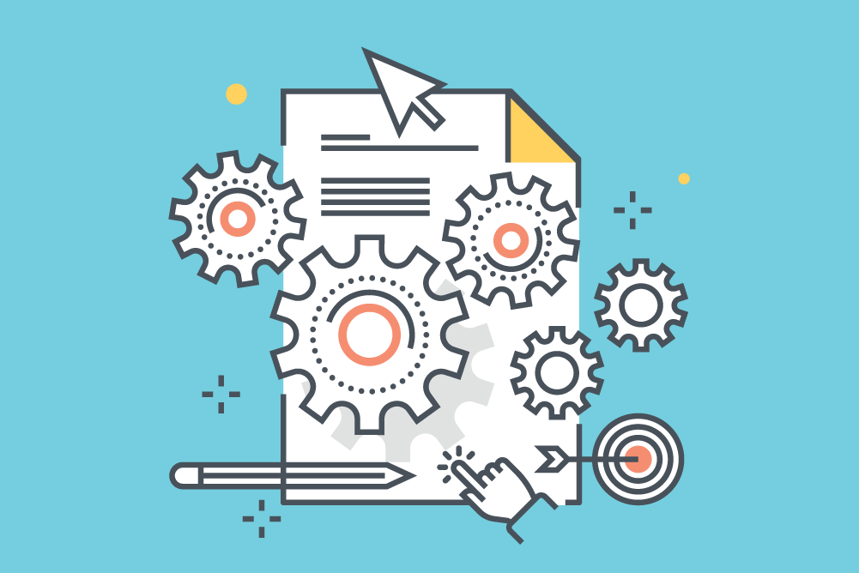
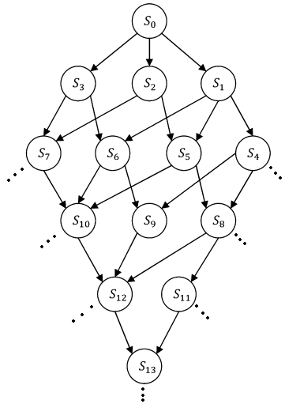
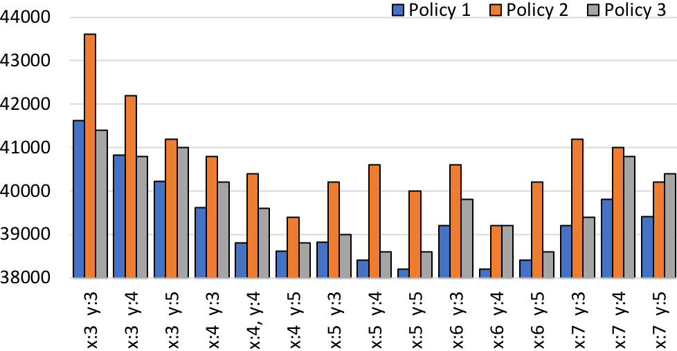
AdaptiveFlow Framework
State space
(Timed Transition System)
Adaptation Policies
Topology
Env.
Cnfg.
Timed Rebeca model
Model generation
Safety verification
Change input
Record results
Performance Evaluation
Yes
No
More experiments?

Slide 6
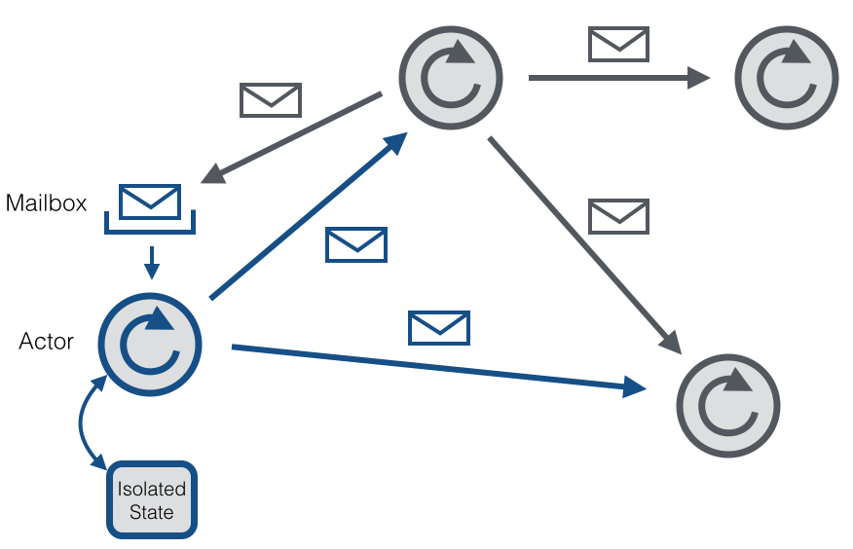
Rebeca: The Modeling Language
Rebeca: Reactive object language
Based on Hewitt actors
Concurrent reactive objects (OO)
Java-like syntax
Communication:
Asynchronous message passing
No explicit receive
Computation:
Take a message from top of the queue and execute it
Event-driven
Timed Rebeca (TRebeca):
An extension of Rebeca with timing primitives

Slide 7
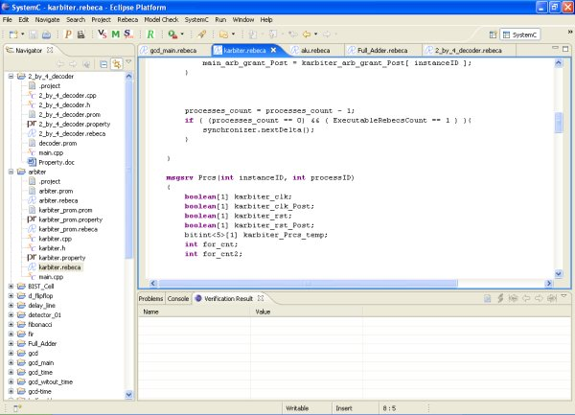
Rebeca: Tool Support
Project editor
Model and Property editor
Model checking result view
http://www.rebeca-lang.org/

Slide 8
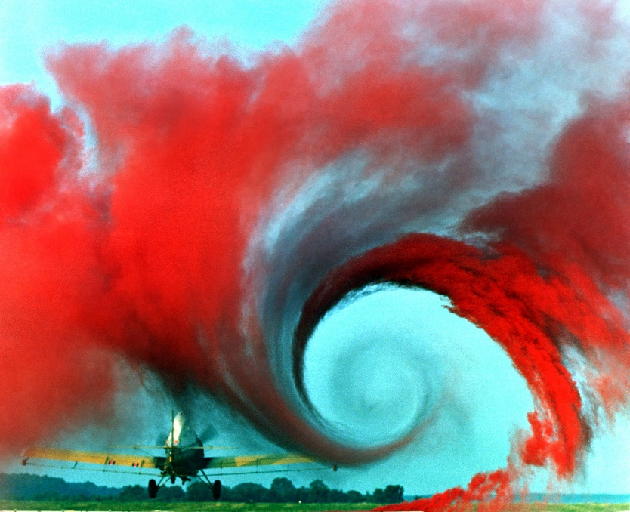
Actor Templates in AdaptiveFlow
Eulerian
Eulerian:
segments as actors
moving objects as messages
Lagrangian:
moving objects as actors
actors have some global view
helping in autonomous decision making
Lagrangian

Slide 9
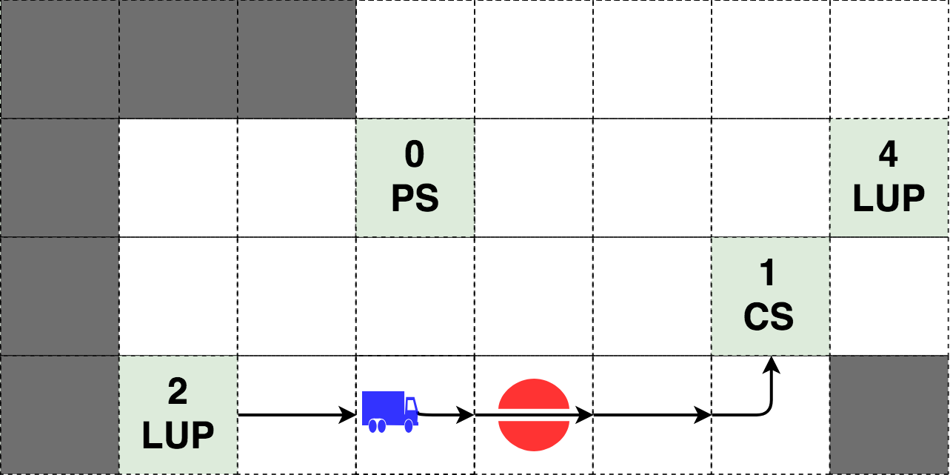
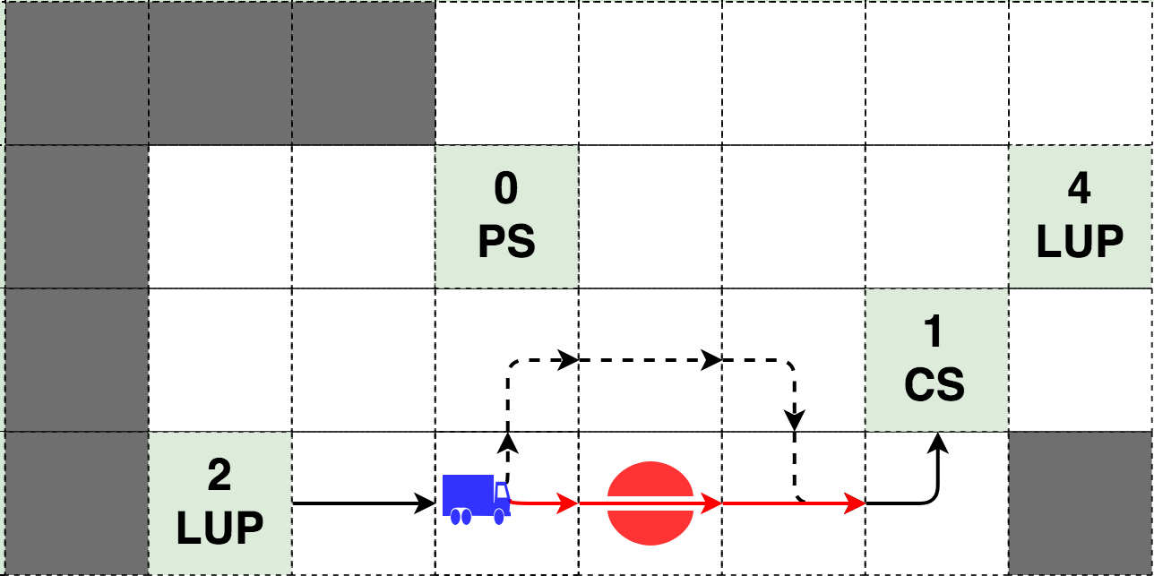
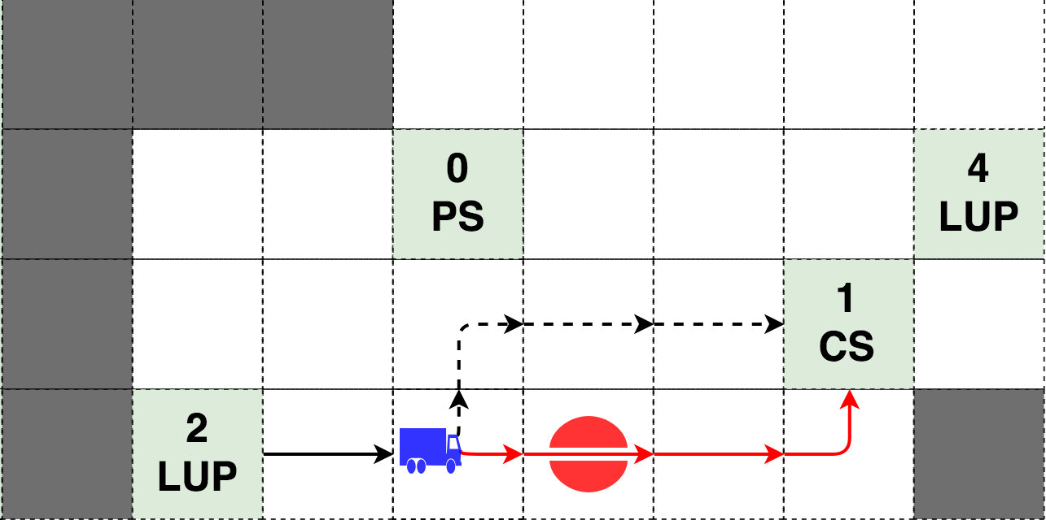
Adaptive Policies in AdaptiveFlow
Policy 1: wait & try again later
0_2 > 0_3 > 1_4 > 1_5 > 1_6
0_2 > 0_3 > 1_4 > 1_5 > 1_6
Policy 2: overpass segment
0_2 > 0_3 > 1_4 > 1_5 > 1_6
0_2 > 0_3 > 0_4 > 0_5 > 1_5 > 1_6
Policy 3: Re-route
0_2 > 0_3 > 1_4 > 1_5 > 1_6
0_2 > 0_3 > 0_4 > 0_5 > 1_6

Slide 10
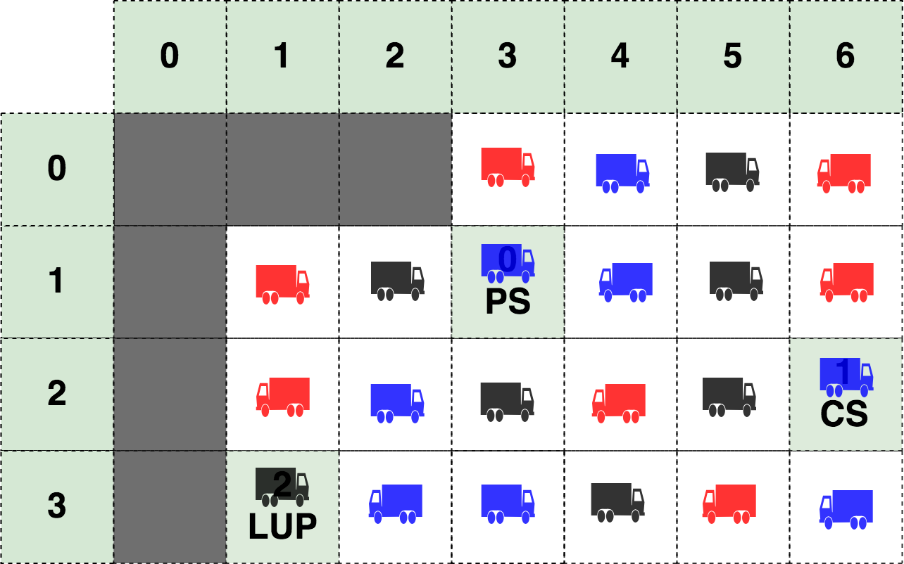
Safety & Performance Analysis
Safety Verification
Deadline misses
Deadlock
Starvation
Fuel outage
Collisions
Wrong movements
Performance Evaluation
Consumed Fuel
Emitted CO2
Transported Material
Operational time
Travel Distances
Starvation situation

Slide 11
Optimization
Essentially, all models are wrong, but some are useful.
Experiments
Moving PoIs within the environment
Change configuration of machines
Change sequence of tasks to execute
Change environment features
Try different Adaptive Policies
...
Configurations Comparison
The best position for the PoIs
Which is the most productive machine
Optimize tasks scheduling
Update the environment configuration
Select the most suitable Policy
...
GOAL

Slide 12
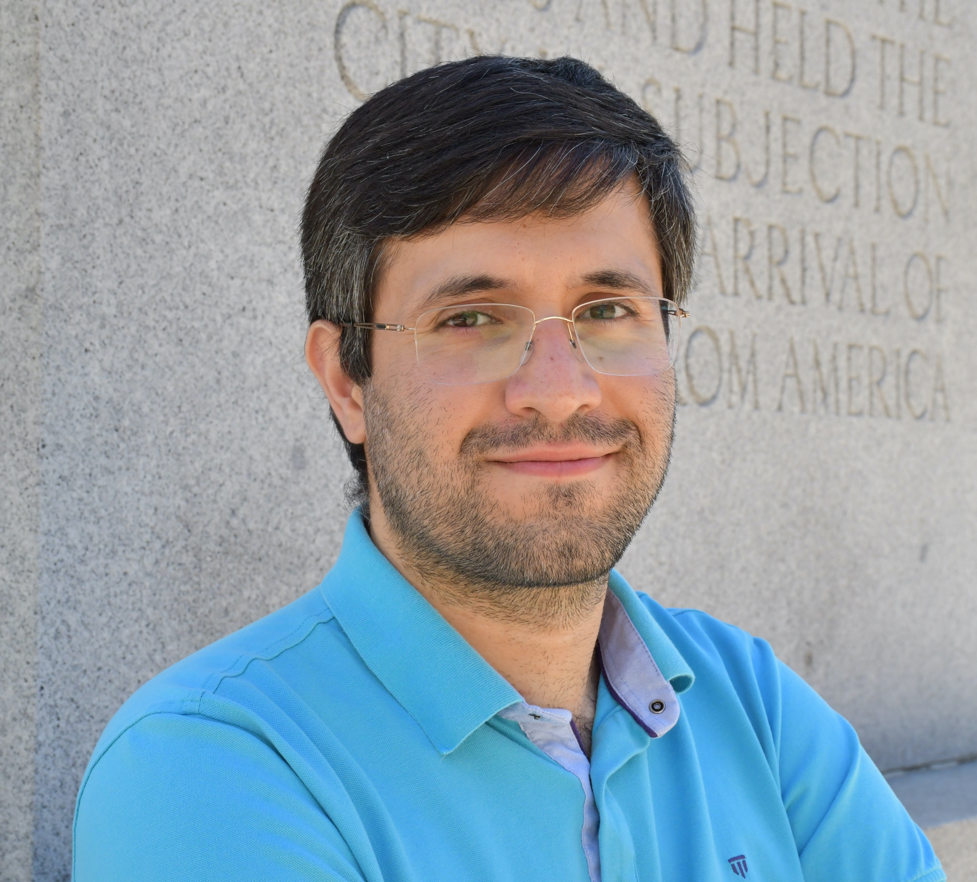
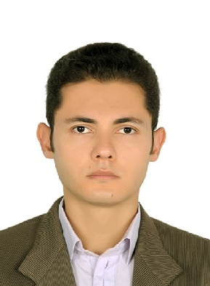
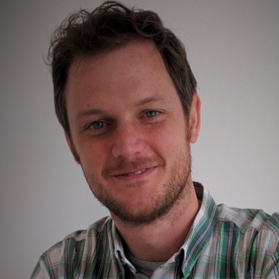
Project Team
Torbjörn Martinsson
Volvo CE
Stephan Baumgart
MDH, Volvo CE
Ehsan Khamespanah
RU
Marjan Sirjani
MDH
Ali Sedaghatbaf
MDH
Ali Jafari
RU
Giorgio Forcina
MDH
Jonn Lantz
Volvo Cars

Slide 13
Publication
An Actor-based Design Platform for System of Systems
Authors: Marjan Sirjani, Giorgio Forcina, Ali Jafari, Stephan Baumgart, Ehsan Khamespanah, Ali Sedaghatbaf

Slide 14
Sponsors
This work is financed by:

